Slide 1
Exporting
Social Media Sharing
In the slide thumbnail pane, on the left side of the PowerPoint window, select the slide you want to save.
Click File > Save As. Navigate to the folder where you want to save your slide.
Type the name of your slide image in the File name text box.
Click to open the Save as Type drop-down menu. Select JPEG File Interchange Format (.jpg).
Click Save. Review the PowerPoint dialog box, and select Just This One to save your selected slide as an image
Hashtag #cloudLibrary #eBooks #Audiobooks
We would love to follow you! Let us know by emailing marketing-global@bibliotheca.com
Our accounts
Facebook [LINK]
LinkedIn [LINK]
Twitter
bibliotheca [LINK]
Youtube [LINK]

Slide 2
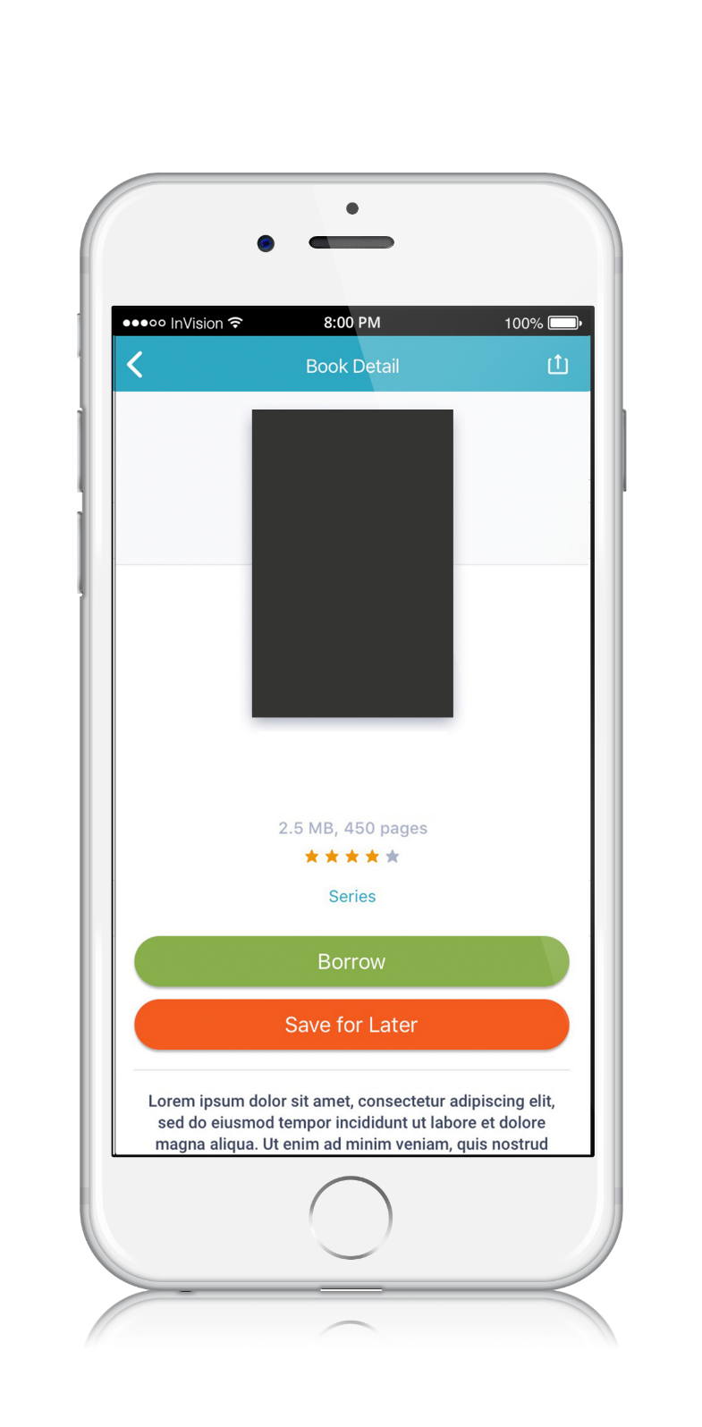
Get the latest Audiobooks on cloudLibrary
INSERT BOOK COVER
The Home Edit Life
Shearer, Clea; Teplin, Joanna

Slide 3
Get the latest eBooks on cloudLibrary
The Roommate
Danan, Rosie
Now available on cloudLibrary

Slide 4
The Roommate
Danan, Rosie

Slide 5
New teen reads available on cloudLibrary
INSERT BOOK COVER
Sanctuary
Mendoza, Paola; Sher, Abby

Slide 6
New fiction favorites are on cloudLibrary
The Roommate
Danan, Rosie
Now available on cloudLibrary

Slide 7
The season’s biggest books are on cloudLibrary
INSERT BOOK COVER
Return to Virgin River
Carr, Robyn
Now available on cloudLibrary

